Slide 1
TOPIC A1:
COMPUTER FUNDAMENTALS
HL ONLY
LESSON A1-8
CONTROL SYSTEMS

Slide 2
AGENDA
Input, process, output, feedback
Open-loop and closed-loop
The components
The thermostat
Real-world control systems
Control loops and the scheduler
Lab
Close
WHAT U NEED 4 LESSON
Guided Notes
Your Lesson A1-8 Guided Notes
A pen
No calculator

Slide 3

THE WARM UP QUESTION
(a) State what is meant by latency [1]
(b) A device generates events very rarely and runs on a battery. State whether polling or interrupt handling is the better choice [1]
(c) State one cost of a context switch [1]
→ Notes Q1 (a), (b), (c)

Slide 4
THE WARM UP ANSWER
(a) The delay between an event happening and the system responding to it
(b) Interrupts — rare events, and polling would drain the battery quickly for no real benefit
(c) CPU time spent saving and restoring registers instead of doing real work

Slide 5
INPUT, PROCESS, OUTPUT, FEEDBACK
Last lesson we talked about how the OS decides which program runs on the CPU at what time
Today, we talk about how computers perform operations
  Such as operating a machine
A control system takes an input, processes it, and produces an output
  Can you all think of anything you own that is a control system
Input
Output
Process

Slide 6
INPUT, PROCESS, OUTPUT, FEEDBACK
Feedback is the process measuring the output and sending it back as part of the input
  The system can then tell whether what it did actually worked, if it should continue the same thing, or if it should begin to do something different
If I’m running a heater, and I set the temperature, but the heater doesn’t check the heat in the room, how will it know to stop making things warmer?
→ Notes Q2 (a) and (b) [3 marks]
Input
Output
Process

Slide 7
OPEN-LOOP AND CLOSED-LOOP
Open-loop: no feedback. The output does not affect the next decision.
Closed-loop: the output is measured and fed back in. Feedback
It’s a different design, but machines can run both ways
  It all depends on if there’s feedback involved or not
Input
Output
Output
Input
Process
Process

Slide 8
OPEN-LOOP AND CLOSED-LOOP
In each of these cases, which is the better solution to the problem?
→ Notes Q3 (a), (b) and (c) [4 marks]
Job | Open-loop version | Closed-loop version
Watering | Runs 20 min at 6am | Runs until the soil sensor reads wet
Toasting | Runs for 2 minutes | Runs until the browning sensor trips
Traffic | Changes every 45 s | Changes when the road loop counts no cars going through the light

Slide 9
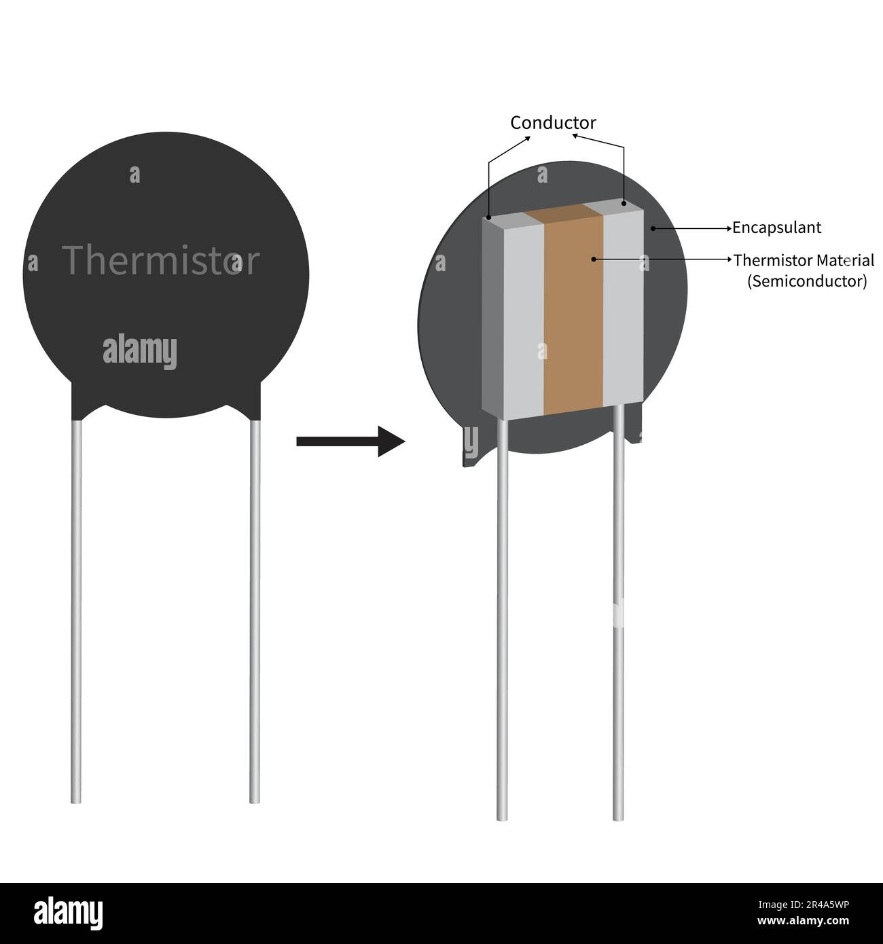
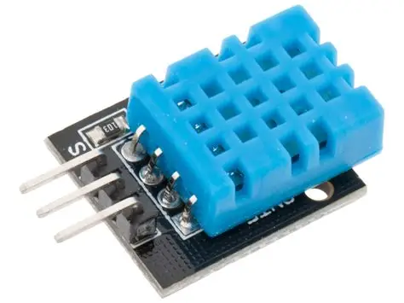
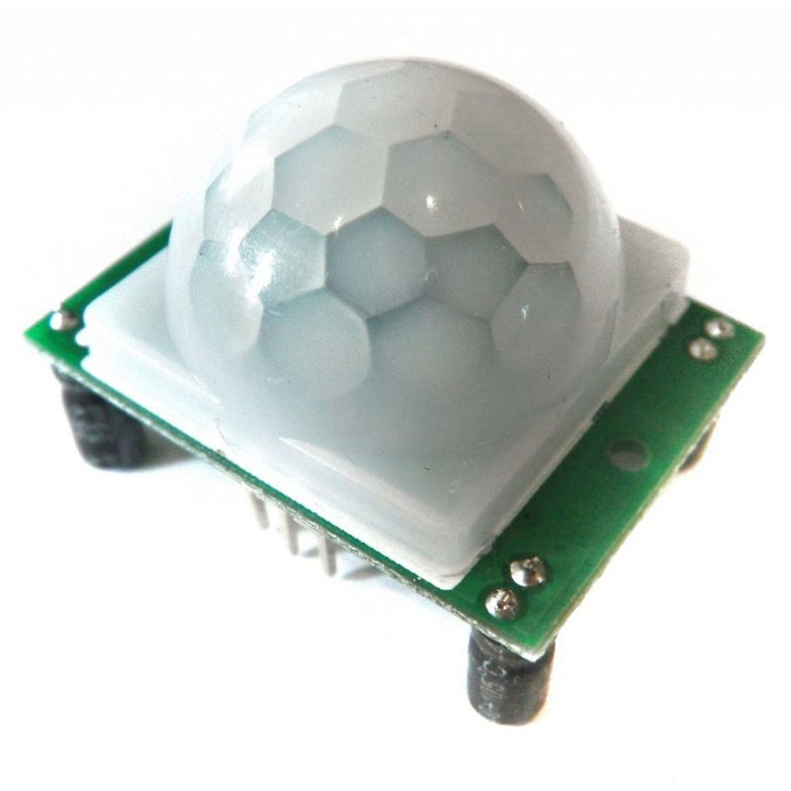
THE COMPONENTS
A sensor measures something physical and turns it into a signal
  Examples: Thermistor (temperature sensor), humidity sensor, motion sensor, etc.
A transducer converts energy from one form into another
  Every sensor is a transducer, so is anything that takes a digital signal and converts it to something in the real world

Slide 10
THE COMPONENTS
The controller runs the control algorithm and decides what to do
  This is the computer in the situation, often a microchip
An actuator is the part that acts, or moves, like a motor, valve, heating element
  This is also a transducer, just like the sensors
→ Notes Q4 (a) and (b) [5 marks]
Component | In a thermostat
Sensor | Thermistor reading room temperature
Controller | The chip comparing the reading to the set point
Control algorithm | The on / off rule it follows
Actuator | The relay that switches the heater on

Slide 11
THE THERMOSTAT
The set point is the temperature you asked for: 72.0 °F
The error is the difference between the set point and the current reading
Switching at exactly 72.0 would make the boiler toggle as it fluctuates between 71 and 72

Slide 12

THE THERMOSTAT
So the rule uses a dead band instead
Turn the heater on if the temperature is below 71.5 °F, OFF above 72.5 °F, nothing in between
If the temperature is hovering at 71.9 / 72.1 / 71.95:
  If the logic simply switches the heater on as soon as it’s higher than 21, the heater is toggling on and off
  Wasting energy as it toggles and has to turn back on

Slide 13
THE THERMOSTAT
Using a trace table, and assuming that the heater begins in an OFF state
→ Notes Q5 (a) [3 marks] — fill the last column
Time (min) | Temp (°C) | Heater
0 | 70.8
5 | 71.2
10 | 71.7
15 | 72.1
20 | 72.6
25 | 72.3
30 | 71.8
35 | 71.4

Slide 14
THE THERMOSTAT
Using a trace table, and assuming that the heater begins in an OFF state
→ Notes Q5 (a) [3 marks] — fill the last column
Time (min) | Temp (°C) | Heater
0 | 70.8 | ON
5 | 71.2 | ON
10 | 71.7 | ON
15 | 72.1 | ON
20 | 72.6 | OFF
25 | 72.3 | OFF
30 | 71.8 | OFF
35 | 71.4 | ON

Slide 15
THE THERMOSTAT
The output depends on what the system did before, not just the reading
→ Notes Q5 (b) [2 marks]

Slide 16
REAL-WORLD CONTROL SYSTEMS
What are the input and output for each of these control systems?
Automatic doors
Elevators
Washing machines

Slide 17
REAL-WORLD CONTROL SYSTEMS
Automatic doors:
  Input: Motion sensor
  Output: Actuator to open door
Elevators: position sensor tells the controller when to stop level
  Inputs: Position sensor, button press
  Output: Movement of elevator to position
Washing machines:
  Input: water-level switch, thermostat, and cycle time
  Output: heating water, dispensing water, motor movement

Slide 18
REAL-WORLD CONTROL SYSTEMS
How about these?
Autonomous vehicles
Home security

Slide 19
REAL-WORLD CONTROL SYSTEMS
Autonomous vehicles: dozens of loops running at once
  Inputs: proximity sensors, motion sensors, etc.
  Outputs: turning wheels, motor running
Home security:
  Inputs: switches on doors, motion detector
  Outputs: alarm sound, altering the user

Slide 20
REAL-WORLD CONTROL SYSTEMS
What think we of this table?
System | Open or closed loop?
Traffic lights on a 45 second timer
An elevator stopping level with each floor
A washing machine filling to a level switch

Slide 21
REAL-WORLD CONTROL SYSTEMS
What think we of this table?
System | Open or closed loop?
Traffic lights on a 45 second timer | Open
An elevator stopping level with each floor | Closed
A washing machine filling to a level switch | Closed

Slide 22
CONTROL LOOPS AND THE SCHEDULER
A control loop is a process, and it typically has a deadline
If a control system loops every 20 ms and it takes this much time to perform each task
  read (input) 2 ms
  decide (process) 3 ms
  act (output) 1 ms
6 ms of work in a 20 ms period, so 30% of the CPU’s time and 14 msto spare
→ Notes Q7 (a) [2 marks]

Slide 23
CONTROL LOOPS AND THE SCHEDULER
Now, let’s assume that something, maybe an interrupt, delays the scheduler by 15 ms
6 + 15 = 21 ms, but our cycle time is only 20 ms
  One of our cycles is missed!
Polling could become part of our cycle and avoid this happening, if this happening is catastrophic
→ Notes Q7 (b) [1 mark]

Slide 24
LAB
→ Notes Q8, Q9 and Q10 [8 marks]
Q8 Describe the role of the control algorithm in a closed-loop system [2]
Q9 Explain why a fixed-response system cannot use a long time quantum [3]
Q10 Evaluate a soil moisture sensor against an open-loop timer for a sprinkler in a field [3]

Slide 25
CLOSE
HL ONLY
WS A1-4 — Control Systems is on GitHub, due next lesson

Slide 26

VOCABULARY TO REMEMBER
Control system
Input
Process
Output
Feedback
Open-loop
Closed-loop
Sensor
Transducer
Controller
Actuator
Control algorithm
Set point
Error
Dead band
Deadline

